Slide 1
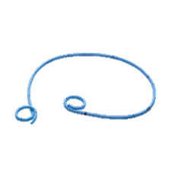
URETERAL STENT
OR
DOUBLE J STENT (DJ STENT)
PREPARED BY : Mr, SAJID KHAN
DISCIPLINE : SURGICAL
SUBJECT : DIAGNOSTIC IMAGING

Slide 2
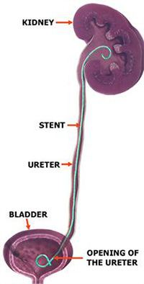
DOUBLE J STENTING:
What is DJ stenting ?
A procedure in which flexible tube is placed in the ureter to help drain the urine.
Need to place DJ STENT ?
To prevent postoperative swelling after kidney stone removal.
To prevent blockage by crushed stones.
To heal the area quickly after surgery.
To prevent ureteral obstructions due to blood clots.

Slide 3
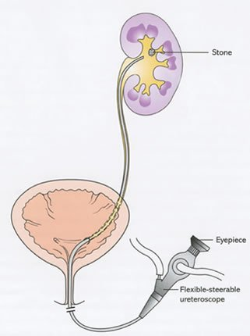
How is DJ stent removed ?
Through process of cystoscopy
Local anesthetic jelly is placed in the urinary passage
a scope is inserted
DJ stent is visualized
Extracted using an endoscopic forceps

Slide 4
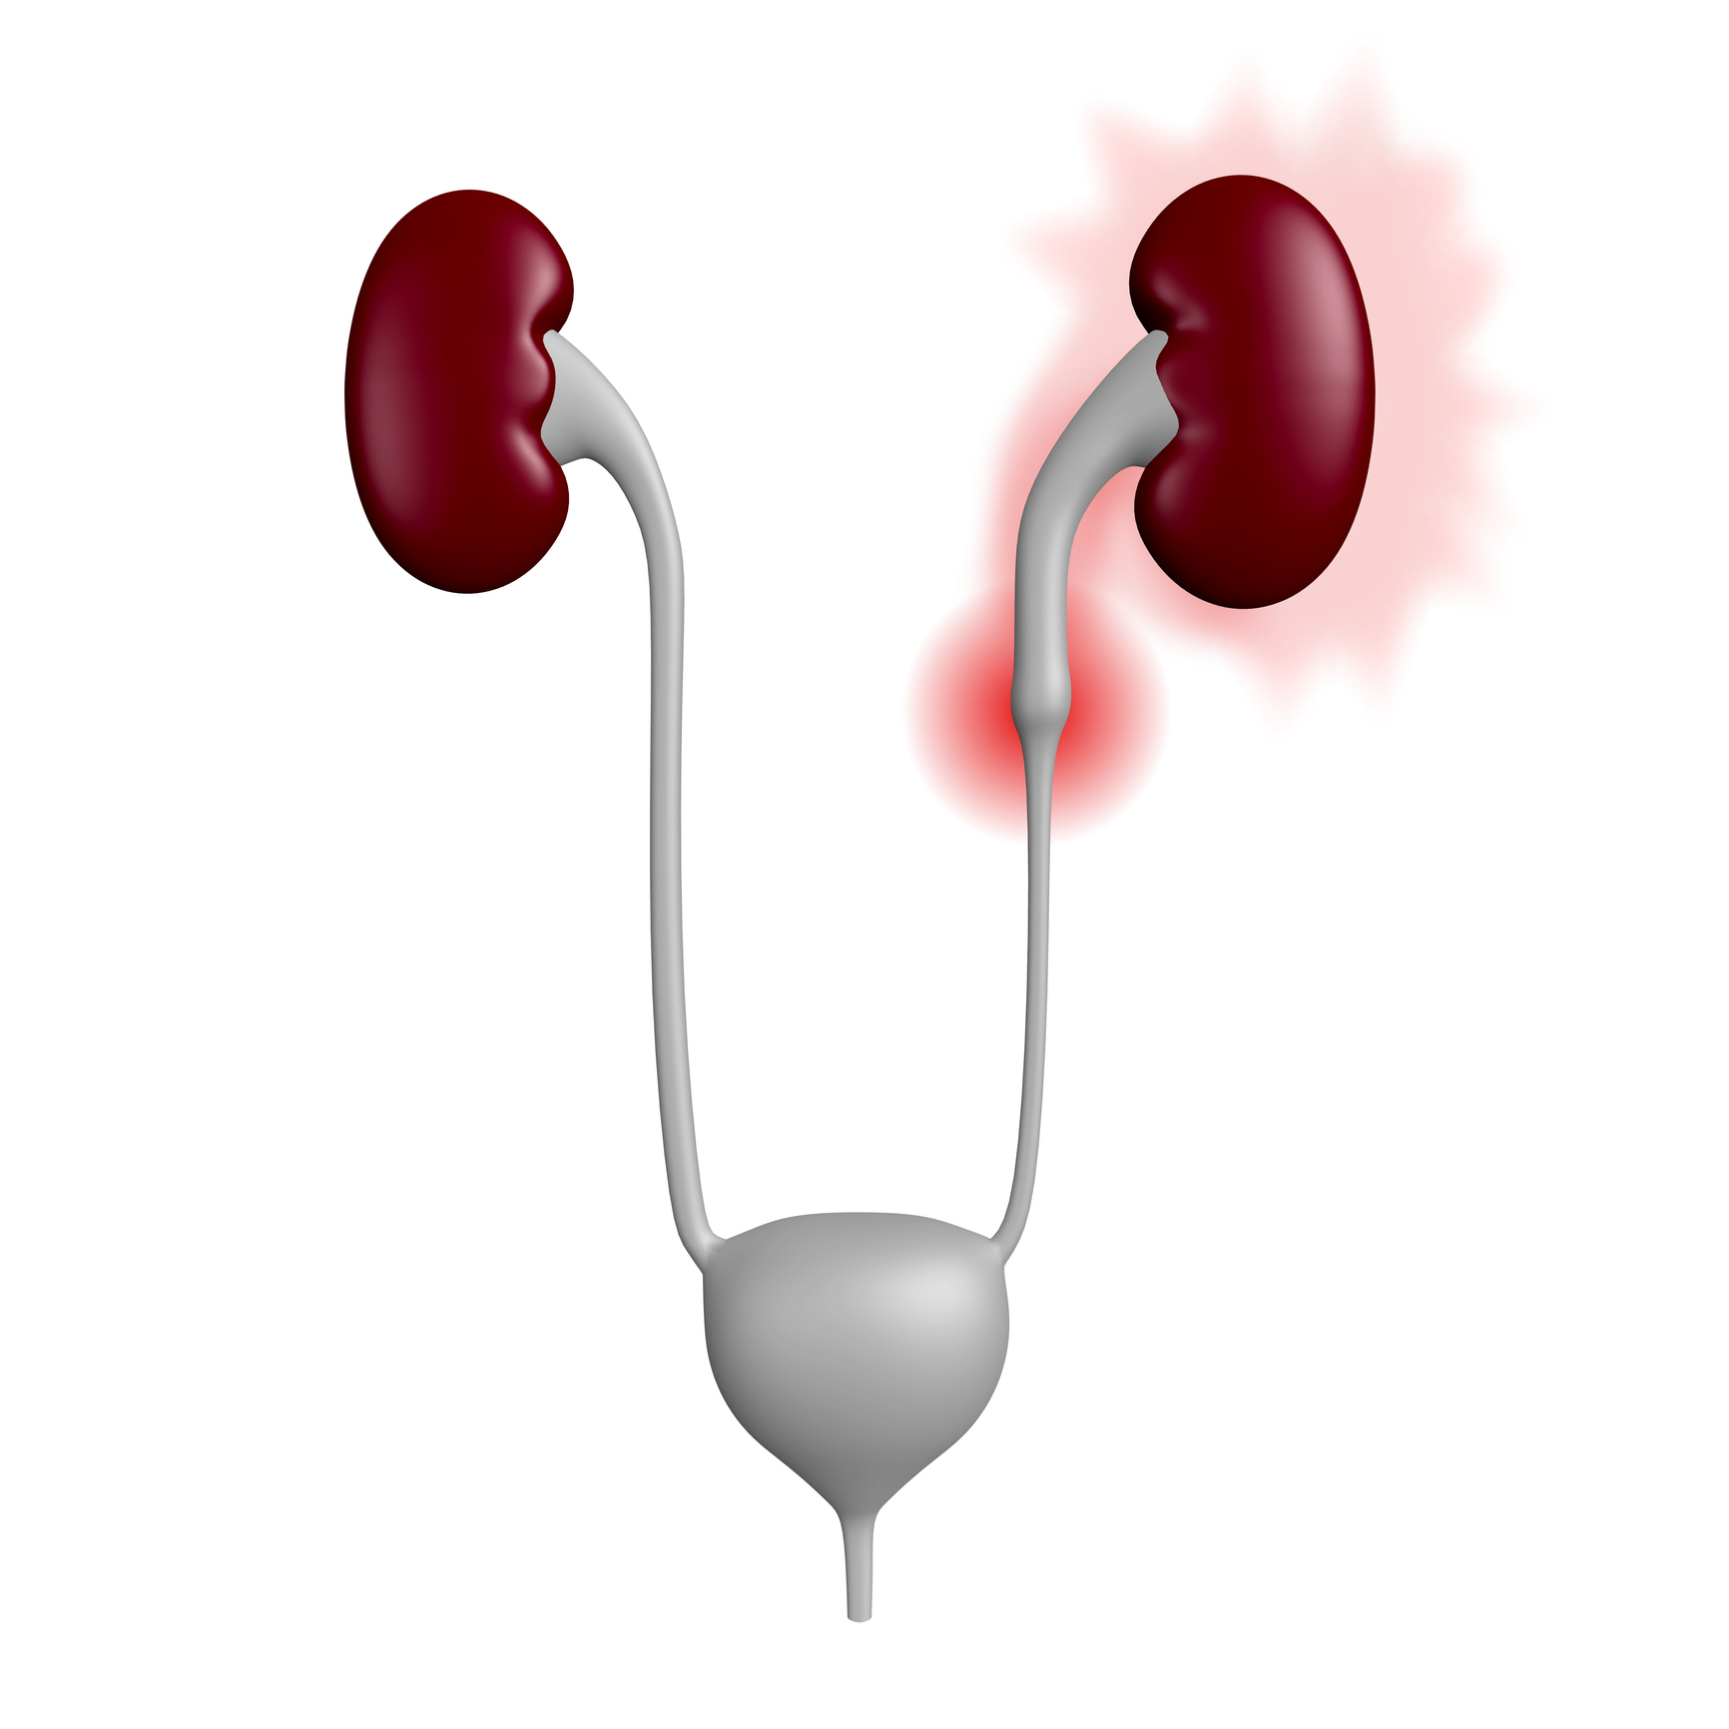
COMPLICATIONS :
MAJOR SIDE EFFECTS:
Vesico –ureteric reflux
Migration
Encrustation
Urinary infection
Stent fracture
Necrosis
Ureteroarterial fistula
MINOR SIDE EFFECTS :
Hematuria
Dysuria
Frequency
Flank
Supra pubic pain

Slide 5
Thank you

